Slide 1
Data Structure and Algorithms-I
Introduction to Asymptotic
Analysis
Lecturer Saifur Rahman, Dept. of CSE, United International University

Slide 2
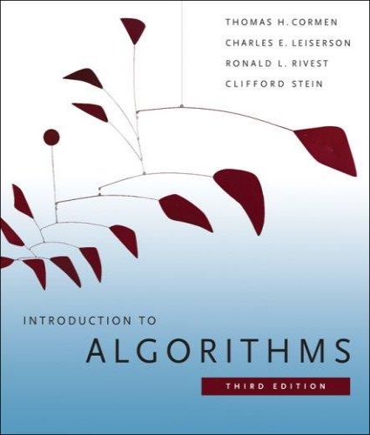
The Course
Purpose: a rigorous introduction to the design and analysis of algorithms
Not a programming course
Not a math course, either
Textbook: Introduction to Algorithms (3rd edition)
Cormen, Leiserson, Rivest, and Stein
An excellent reference you should own
Lecturer Saifur Rahman, Dept. of CSE, United International University

Slide 3
What is a Data Structure?
Data is a collection of facts, such as values, numbers, words, measurements, or observations.
Structure means a set of rules that holds the data together.
A data structure is a particular way of storing and organizing data in a computer so that it can be used efficiently.
Different kinds of data structures are suited to different kinds of applications, and some are highly specialized to specific tasks.
Data Structures provide a means to manage huge amount of data efficiently.
Usually, efficient data structures are a key to designing efficient algorithms.
Data structures can be nested.
Lecturer Saifur Rahman, Dept. of CSE, United International University

Slide 4
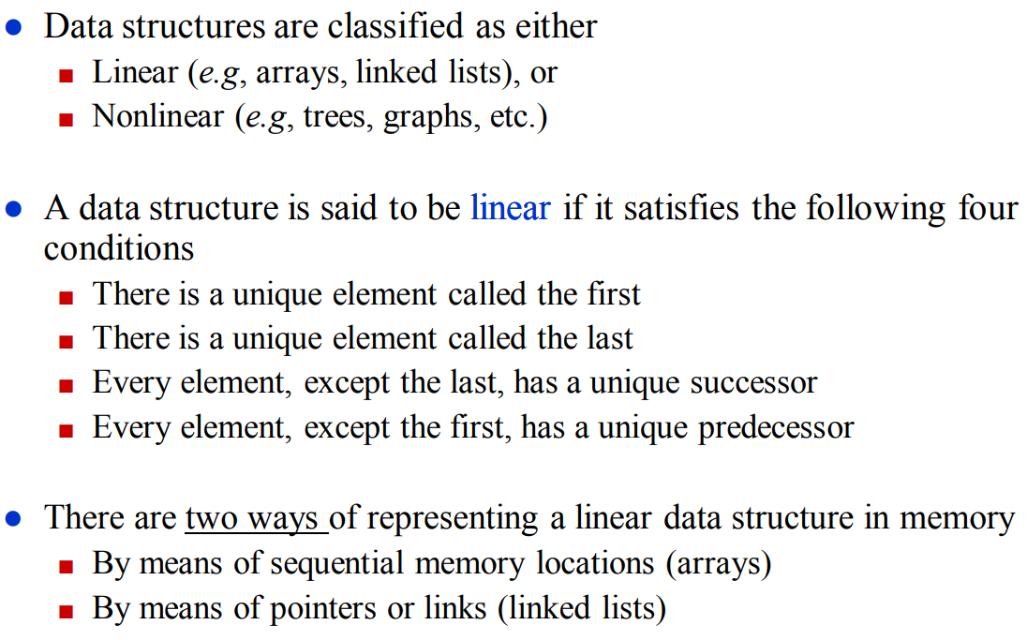
Types of Data Structures
Lecturer Saifur Rahman, Dept. of CSE, United International University

Slide 5
What is an Algorithm?
An algorithm is a sequence of computational steps that solves a well-specified computational problem.
An algorithm is said to be correct if, for every input instance, it halts with the correct output
An incorrect algorithm might not halt at all on some input instances, or it might halt with other than the desired output.
Lecturer Saifur Rahman, Dept. of CSE, United International University

Slide 6

What is a Program?
A program is the expression of an algorithm in a programming language
A set of instructions which the computer will follow to solve a problem
Lecturer Saifur Rahman, Dept. of CSE, United International University

Slide 7
Define a Problem, and Solve It
Problem:
Description of Input-Output relationship
Algorithm:
A sequence of computational steps that transform the input into the output.
Data Structure:
An organized method of storing and retrieving data.
Our Task:
Given a problem, design a correct and good algorithm that solves it.
Lecturer Saifur Rahman, Dept. of CSE, United International University

Slide 8
Define a Problem, and Solve It
Problem: Input is a sequence of integers stored in an array.
Output the minimum.
INPUT
Algorithm
OUTPUT
instance
m:= a[1];
for I:=2 to size of input
if m > a[i] then
m:=a[I];
return s
25, 90, 53, 23, 11, 34
11
m, a[i]
Data-Structure
Lecturer Saifur Rahman, Dept. of CSE, United International University

Slide 9
What do we Analyze?
Correctness
Does the input/output relation match algorithm requirement?
Amount of work done (complexity)
Basic operations to do task
Amount of space used
Memory used
Simplicity, clarity
Verification and implementation.
Optimality
Is it impossible to do better?
Lecturer Saifur Rahman, Dept. of CSE, United International University

Slide 10
Running Time
Number of primitive steps that are executed
Except for time of executing a function call most statements roughly require the same amount of time
y = m * x + b
c = 5 / 9 * (t - 32 )
z = f(x) + g(y)
We can be more exact if need to be
Lecturer Saifur Rahman, Dept. of CSE, United International University

Slide 11
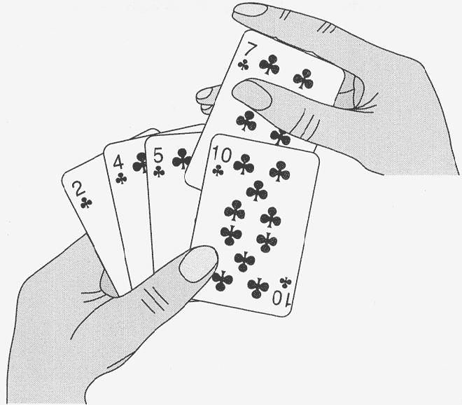
An Example: Insertion Sort
Lecturer Saifur Rahman, Dept. of CSE, United International University

Slide 12
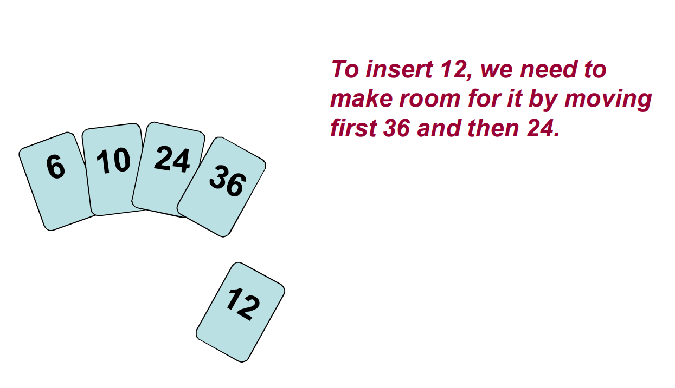
An Example: Insertion Sort
Lecturer Saifur Rahman, Dept. of CSE, United International University

Slide 13
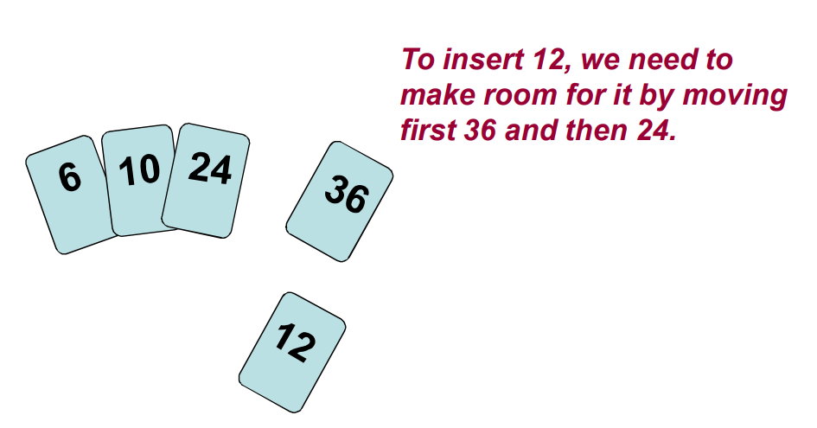
An Example: Insertion Sort
Lecturer Saifur Rahman, Dept. of CSE, United International University

Slide 14
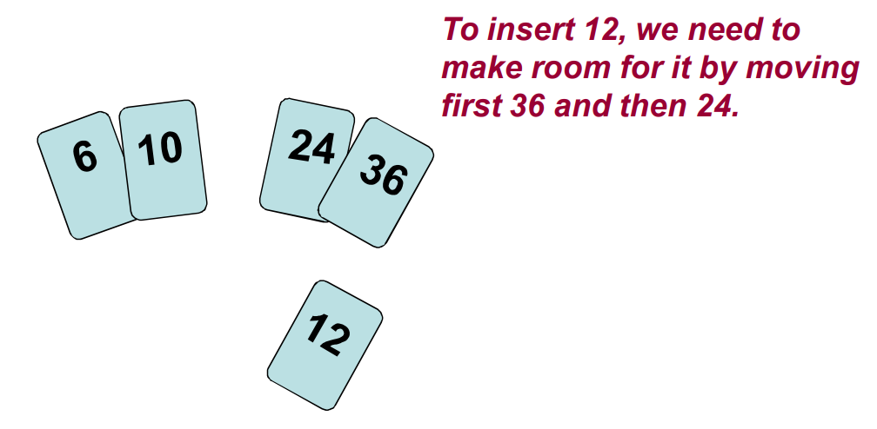
An Example: Insertion Sort
Lecturer Saifur Rahman, Dept. of CSE, United International University

Slide 15
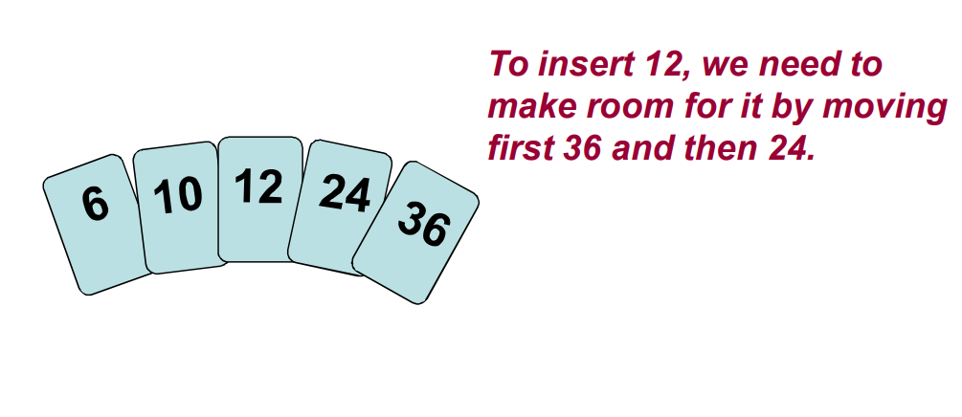
An Example: Insertion Sort
Lecturer Saifur Rahman, Dept. of CSE, United International University

Slide 16
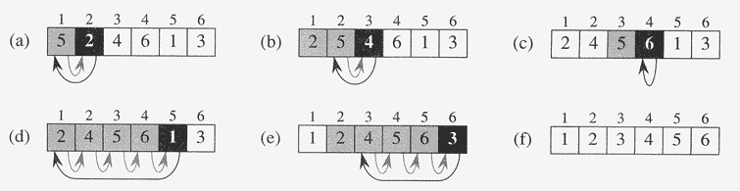
An Example: Insertion Sort
A = {5, 2, 4, 6, 1, 3}
Lecturer Saifur Rahman, Dept. of CSE, United International University

Slide 17
An Example: Insertion Sort
InsertionSort(A, n) { for i = 2 to n { key = A[i] j = i - 1; while (j > 0) and (A[j] > key) { A[j+1] = A[j] j = j - 1 } A[j+1] = key }
}
Lecturer Saifur Rahman, Dept. of CSE, United International University

Slide 18
An Example: Insertion Sort
InsertionSort(A, n) { for i = 2 to n { key = A[i] j = i - 1; while (j > 0) and (A[j] > key) { A[j+1] = A[j] j = j - 1 } A[j+1] = key }
}
How many times will this loop execute?
Lecturer Saifur Rahman, Dept. of CSE, United International University

Slide 19
Analyzing Insertion Sort
Statement Cost Times
InsertionSort(A, n) {
for i = 2 to n { c₁ n
key = A[i] c₂ (n – 1)
j = i – 1; c₃ (n – 1)
while (j > 0) and (A[j] > key) { c₄ T
A[j+1] = A[j] c₅ (T – (n – 1))
j = j – 1 } c₆ (T – (n – 1))
A[j+1] = key c₇ (n – 1)
}
}
T = t₂ + t₃ + … + t_{n}, where t_{i} is the number of while expression evaluations for the i^{th} for loop iteration
Lecturer Saifur Rahman, Dept. of CSE, United International University

Slide 20
Analyzing Insertion Sort
T(n) = c₁n + c₂(n-1) + c₃(n-1) + c₄T + c₅(T - (n-1)) + c₆(T - (n-1)) + c₇(n-1) = c₈T + c₉n + c₁₀
What can T be?
Best case: the array is sorted (inner loop body never executed)
t_{i} = 1 → T = n
T(n) = an + b, a linear function of n
Worst case: the array is reverse sorted (inner loop body executed for all previous elements)
t_{i} = i → T = n(n + 1)/2 - 1
T(n) = an² + bn + c, a quadratic function of n
Average case:
???
Lecturer Saifur Rahman, Dept. of CSE, United International University

Slide 21
Asymptotic Performance
We care most about asymptotic performance
How does the algorithm behave as the problem size gets very large?
Running time
Memory/storage requirements
Bandwidth/power requirements/logic gates/etc.
Lecturer Saifur Rahman, Dept. of CSE, United International University

Slide 22
Asymptotic Analysis
Worst case
Provides an upper bound on running time
An absolute guarantee of required resources
Average case
Provides the expected running time
Very useful, but treat with care: what is “average”?
Random (equally likely) inputs
Real-life inputs
Best case
Lecturer Saifur Rahman, Dept. of CSE, United International University

Slide 23
Upper Bound Notation
We say InsertionSort’s run time is O(n²)
Properly we should say run time is in O(n²)
Read O as “Big-O” (you’ll also hear it as “order”)
In general a function
f(n) is O(g(n)) if there exist positive constants c and n₀ such that 0 ≤ f(n) ≤ c ⋅ g(n) for all n ≥ n₀
Formally
O(g(n)) = { f(n): ∃ positive constants c and n₀ such that 0 ≤ f(n) ≤ c ⋅ g(n) ∀ n ≥ n₀ }
Lecturer Saifur Rahman, Dept. of CSE, United International University

Slide 24
Upper Bound Notation
c.g(n)
time
f(n)
n₀
n
We say g(n) is an asymptotic upper bound for f(n)
Lecturer Saifur Rahman, Dept. of CSE, United International University

Slide 25
Insertion Sort is O(n²)
Proof
The run-time is an² + bn + c
If any of a, b, and c are less than 0, replace the constant with its absolute value
an² + bn + c ≤ (a + b + c)n² + (a + b + c)n + (a + b + c)
≤ 3(a + b + c)n² for n ≥ 1
Let c’ = 3(a + b + c) and let n₀ = 1. Then
an² + bn + c ≤ c’ n² for n ≥ 1
Thus an² + bn + c = O(n²).
Question
Is InsertionSort O(n³) ?
Is InsertionSort O(n) ?
Lecturer Saifur Rahman, Dept. of CSE, United International University

Slide 26
Lower Bound Notation
We say InsertionSort’s run time is Ω(n)
In general a function
f(n) is Ω(g(n)) if ∃ positive constants c and n₀ such that 0 ≤ c⋅g(n) ≤ f(n) ∀ n ≥ n₀
Proof:
Suppose run time is an + b
Assume a and b are positive
an ≤ an + b
Lecturer Saifur Rahman, Dept. of CSE, United International University

Slide 27
Lower Bound Notation
f(n)
time
c.g(n)
n₀
n
We say g(n) is an asymptotic lower bound for f(n)
Lecturer Saifur Rahman, Dept. of CSE, United International University

Slide 28
Asymptotic Tight Bound
A function f(n) is Θ(g(n)) if ∃ positive constants c₁, c₂, and n₀ such that 0 ≤ c₁ g(n) ≤ f(n) ≤ c₂ g(n) ∀ n ≥ n₀
Theorem
f(n) is Θ(g(n)) iff f(n) is both O(g(n)) and Ω(g(n))
Proof:
Lecturer Saifur Rahman, Dept. of CSE, United International University

Slide 29
Asymptotic Tight Bound
c₂.g(n)
f(n)
time
c₁.g(n)
n₀
n
We say g(n) is an asymptotic tight bound for f(n)
Lecturer Saifur Rahman, Dept. of CSE, United International University

Slide 30
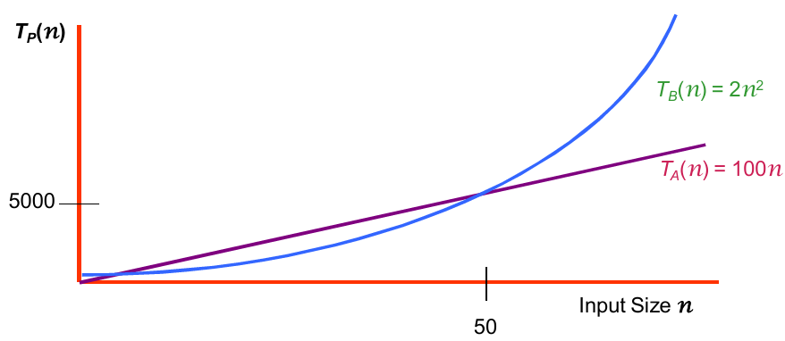
Practical Complexity
For large input sizes, constant terms are insignificant
Program A with running time T_{A}(n)= 100n
Program B with running time T_{B}(n)= 2n²
Lecturer Saifur Rahman, Dept. of CSE, United International University
Notes:
30

Slide 31
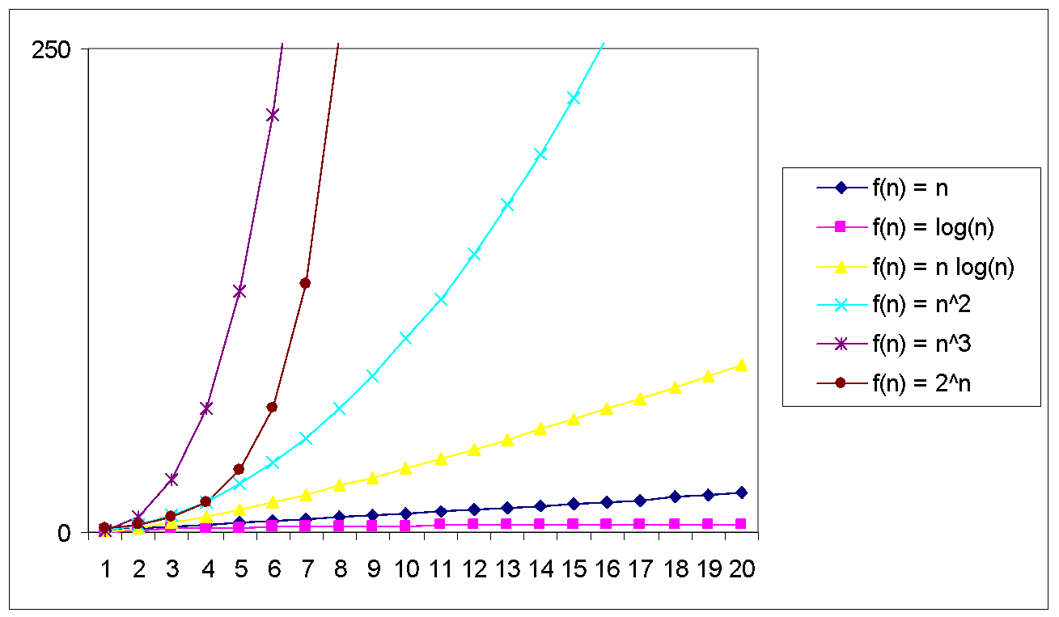
Practical Complexity
Lecturer Saifur Rahman, Dept. of CSE, United International University

Slide 32
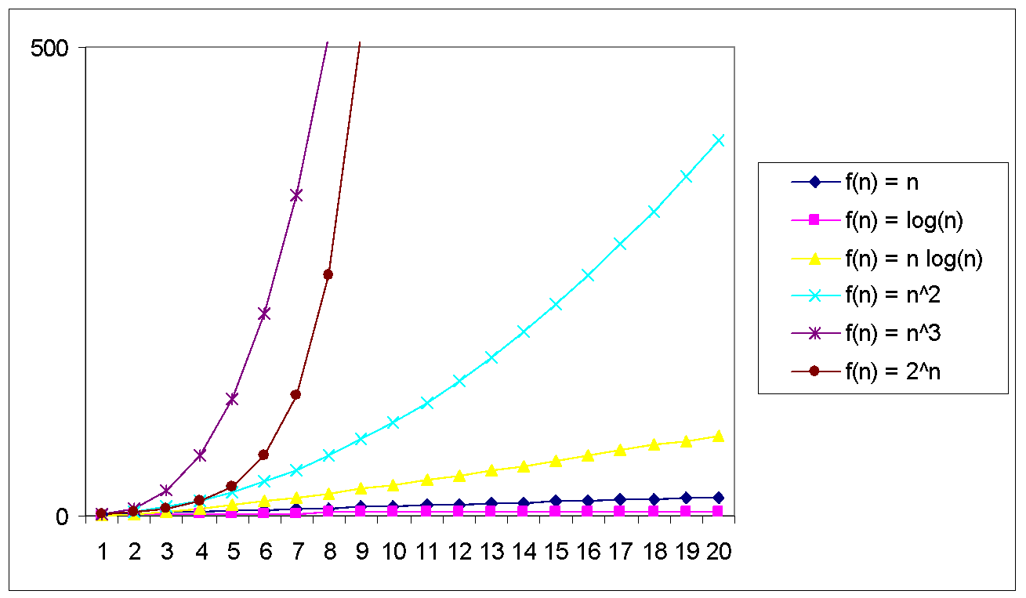
Practical Complexity
Lecturer Saifur Rahman, Dept. of CSE, United International University

Slide 33
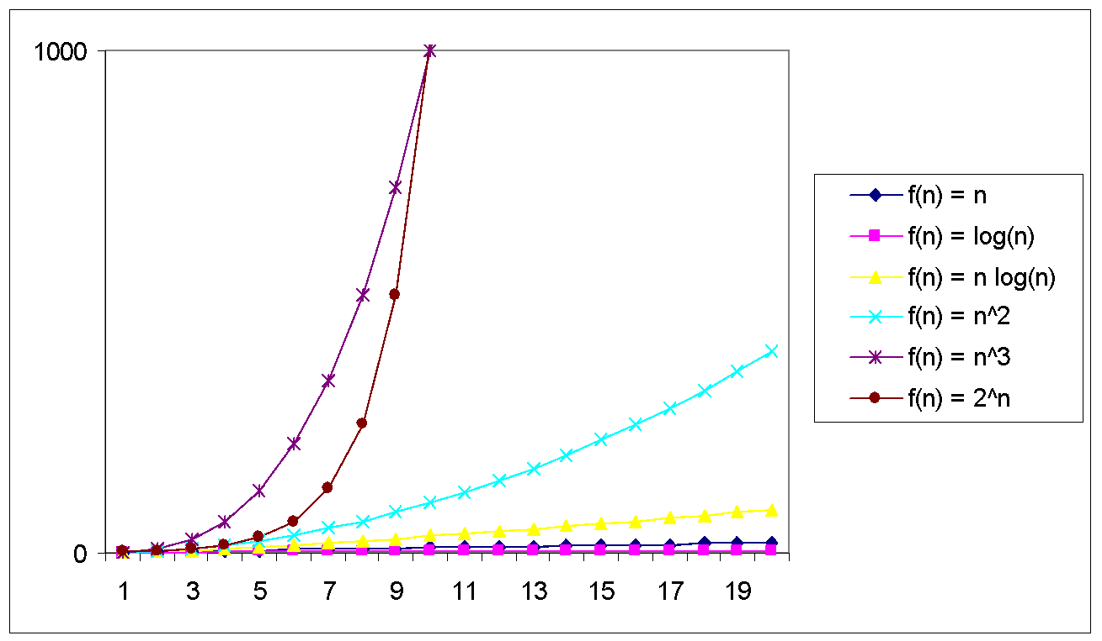
Practical Complexity
Lecturer Saifur Rahman, Dept. of CSE, United International University

Slide 34
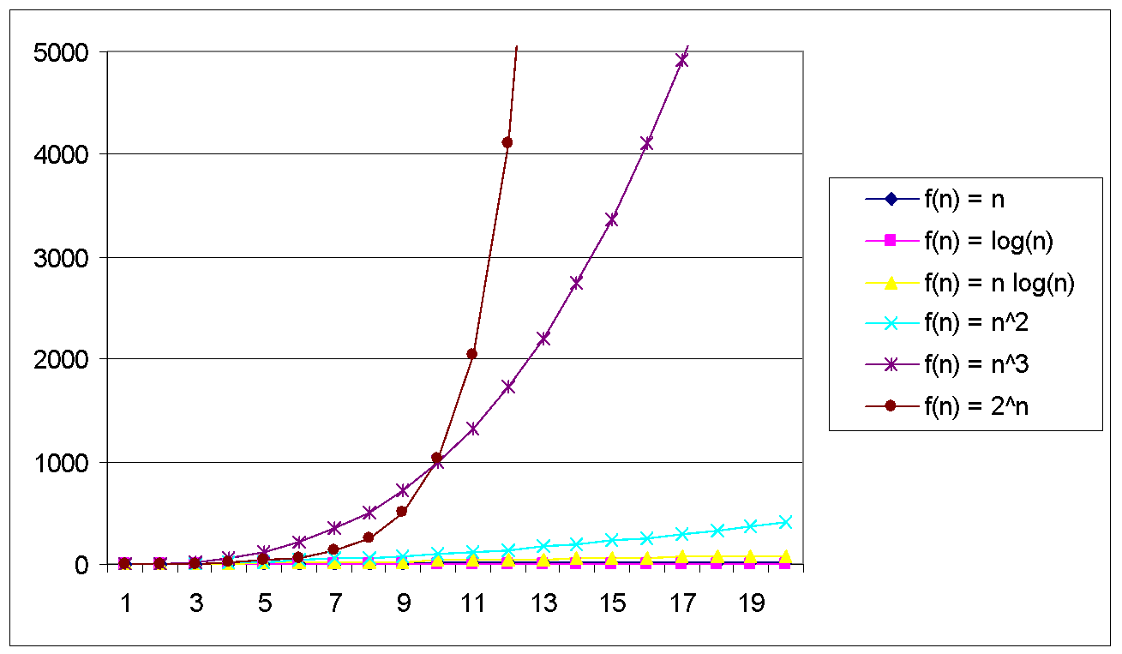
Practical Complexity
Lecturer Saifur Rahman, Dept. of CSE, United International University

Slide 35
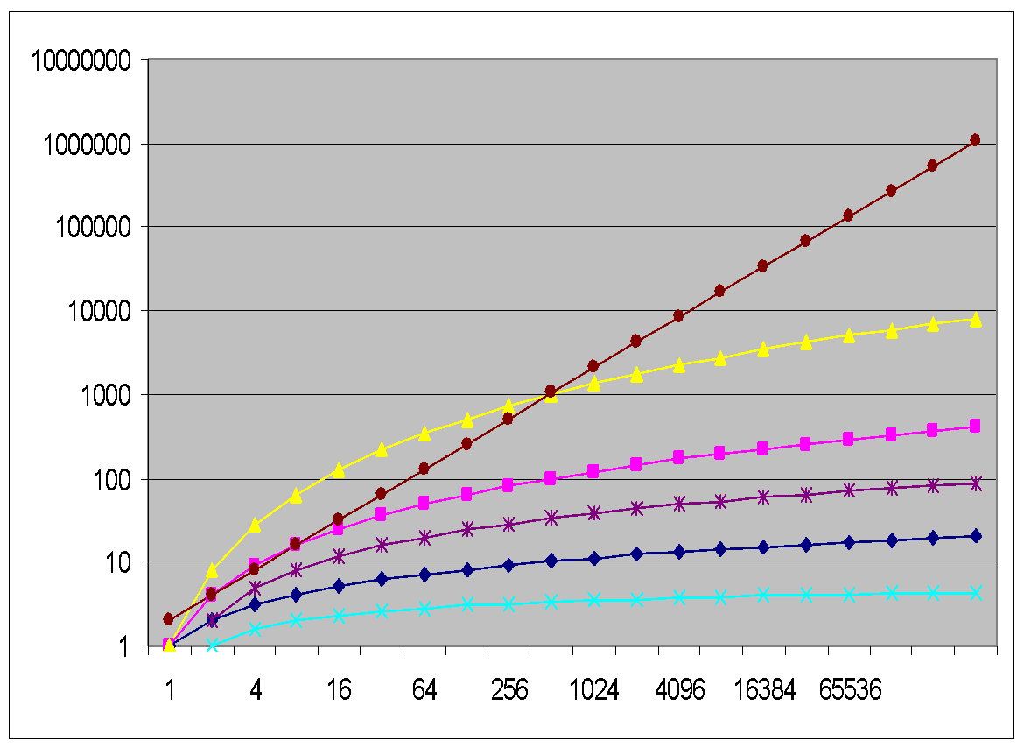
Practical Complexity
f(n) = n
f(n) = log(n)
f(n) = n log(n)
f(n) = n^2
f(n) = n^3
f(n) = 2^n
Lecturer Saifur Rahman, Dept. of CSE, United International University

Slide 36
Practical Complexity
Function | Descriptor | Big-Oh
c | Constant | O( 1 )
log n | Logarithmic | O( log n )
n | Linear | O( n )
n log n | n log n | O( n log n )
n² | Quadratic | O( n² )
n³ | Cubic | O( n³ )
n^{k} | Polynomial | O( n^{k} )
2^{n} | Exponential | O( 2^{n} )
n! | Factorial | O( n! )
Lecturer Saifur Rahman, Dept. of CSE, United International University

Slide 37
Other Asymptotic Notations
A function f(n) is o(g(n)) if ∃ positive constants c and n₀ such that f(n) < c g(n) ∀ n ≥ n₀
A function f(n) is ω(g(n)) if ∃ positive constants c and n₀ such that c g(n) < f(n) ∀ n ≥ n₀
Intuitively,
o( ) is like <
O( ) is like ≤
ω( ) is like >
Ω( ) is like ≥
Θ( ) is like =
Lecturer Saifur Rahman, Dept. of CSE, United International University

